Slide 1




NEXT GEN EMPLOYABILITY PROGRAM
Creating a future-ready workforce
Team Members
College Name
Student Name :R.S Narayani
Student ID : au960221104078
Arunachala College of Engineering for Women

Slide 2

CAPSTONE PROJECT SHOWCASE
Project Title
Car Rentals Application with Django Framework
Abstract | Problem Statement | Project Overview | Proposed Solution | Technology Used | Modelling & Results | Conclusion

Slide 3
Abstract
Our Aim is to design and create a data management System for a car rental company. This enables admin can rent a vehicle that can be used by a customer This system increases customer retention and simplify vehicle and staff Management in an efficient way.This software car Rental System has a very user friendly interface. Thus the users will feel very easy to work on it. By using this system admin can manage customer confirm and cancel booking request, customer Testimonials, customer issues. The car information can be added to the system. Or existed car information can be edited or deleted too by Administrator.There is no delay in the availability of any car information, whenever needed, car information can be Captured very quickly and easily.The customers can also use the system to get car rent. The customer should create a new account before logging in or he / she can log into the System with his/her created account. Then he/she can book the available cars and can book this car .This system will helpful to the admin as well as to the customer also.
Source :

Slide 4
Problem Statement
The problem statement for the car rental application using the Django framework involves creating a user-friendly platform to address the growing demand for convenient and efficient car rental services. The application aims to provide a seamless experience for users to browse, select, and book rental cars while offering a secure and reliable platform for transactions. By leveraging the Django framework, the project will benefit from its robust features and scalability, ensuring that the application can handle increasing user traffic and data management requirements. The focus will be on implementing features such as user authentication, reservation systems, search functionality, and admin panels to streamline the rental process for both customers and administrators. Additionally, the integration of payment gateways and reporting tools will enhance the overall functionality and performance of the application. This project seeks to revolutionize the car rental industry by providing a modern and efficient solution that caters to the needs of a diverse user base.
Source :

Slide 5
Project Overview
The project overview for the car rental application using the Django framework involves creating a comprehensive platform that offers a convenient and user-friendly experience for individuals looking to rent cars. By utilizing the Django framework, the application will benefit from its powerful features and flexibility, allowing for efficient development and scalability. The focus will be on providing a seamless booking process, robust search functionality, secure payment options, and an intuitive admin panel for managing cars and bookings. This project aims to revolutionize the car rental industry by delivering a modern and reliable solution that meets the needs of both customers and rental service providers. The application's user-centric design and advanced features will set it apart in the market, offering a competitive edge and enhancing the overall rental experience for users.
Source :

Slide 6
Proposed Solution
.
To develop a car rental application using the Django framework, several key components need consideration. Firstly, the application's models should encompass essential entities such as users, cars, bookings, and rental locations. Users should be able to register, login, and manage their profiles, while administrators should have control over the fleet and bookings. The application's frontend can be built using Django templates or a frontend framework like React, communicating with the backend via RESTful APIs. Payment integration with a trusted payment gateway ensures secure transactions. Additionally, implementing features like search and filtering for cars, as well as a rating/review system for both users and cars, enhances user experience. Finally, thorough testing, including unit tests for backend logic and integration tests for user workflows, ensures reliability and robustness. By following these guidelines, the car rental application can be efficiently developed and deployed using Django.
Source :

Slide 7
Implementation of a user-friendly interface for easy navigation and booking.
Integration of a robust search feature for users to find specific car types based on their preferences.
Secure user authentication and authorization process to protect user data.
Development of a reservation system for users to book cars in advance.
Inclusion of a payment gateway for secure online transactions.
Creation of an admin panel for managing cars, users, and bookings efficiently.
Implementation of reporting and analytics features for monitoring application performance.
Mobile responsiveness for seamless access on various devices.
Testing strategies to ensure application reliability and functionality.
Scalability considerations to accommodate future growth and increased user traffic.
Source :

Slide 8
Incorporation of data management and storage solutions to handle user information securely.
Deployment plan for launching the application to users.
Training and support for users and administrators to navigate the application effectively.
Continuous updates and maintenance to improve the application's performance and user experience.
Collaboration with car rental agencies to expand the range of available vehicles
Customization options for users to select additional services like insurance or GPS.
Implementation of feedback mechanisms for users to provide input on their rental experience.
Integration of location-based services for users to find rental locations near them.
Inclusion of promotional offers and discounts to attract and retain customers.
Adherence to industry standards and regulations to ensure compliance and trust among users.
Source :

Slide 9

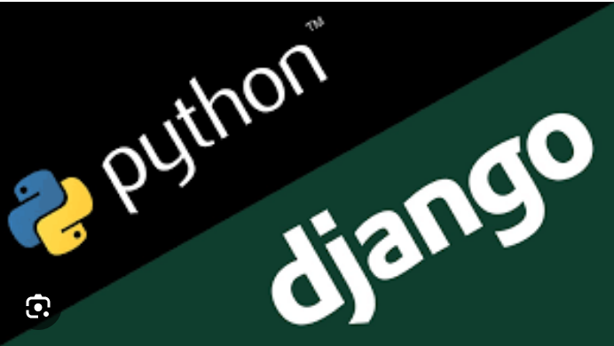
Technology Used
Front-end
Back-end
Source :

Slide 10
Modelling & Results
Building a car rental application using Django involves designing a comprehensive model structure and implementing various functionalities. At the core of the application are the database models, which typically include entities such as cars, users, bookings, and locations. Each model class defines the attributes and relationships necessary for the application's operations. For instance, the Car model may include fields like make, model, year, and availability status, while the Booking model might include details such as the user making the booking, the rented car, the rental period, and the booking status. These models serve as the foundation for storing and managing data within the application.To retrieve results, the application utilizes Django's ORM (Object-Relational Mapping) to execute queries against the database. For example, to display available cars for a given date range, the application would query the Car and Booking models to identify cars that are not already booked during the specified period. This information is then presented to the user through the application's frontend interface, enabling them to make informed decisions and complete the booking process seamlessly. Overall, the combination of robust database modeling, functional implementation, and effective query execution forms the backbone of a successful car rental application built with Django.
Source :

Slide 11
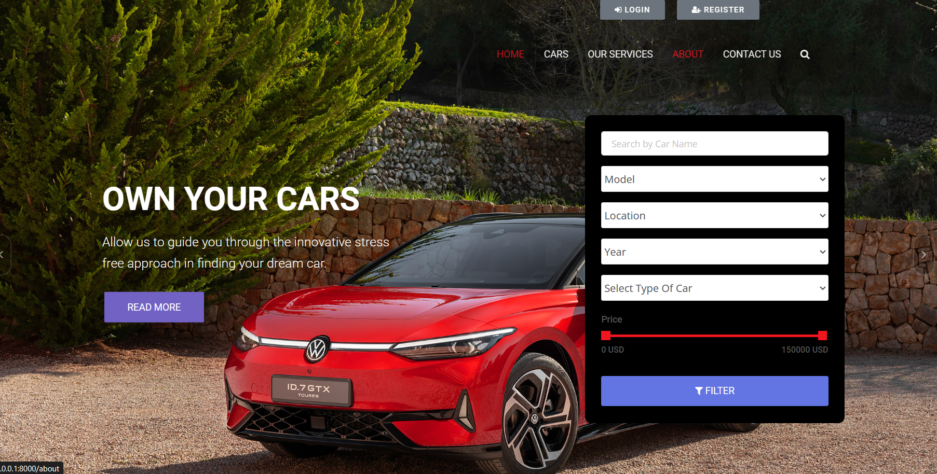
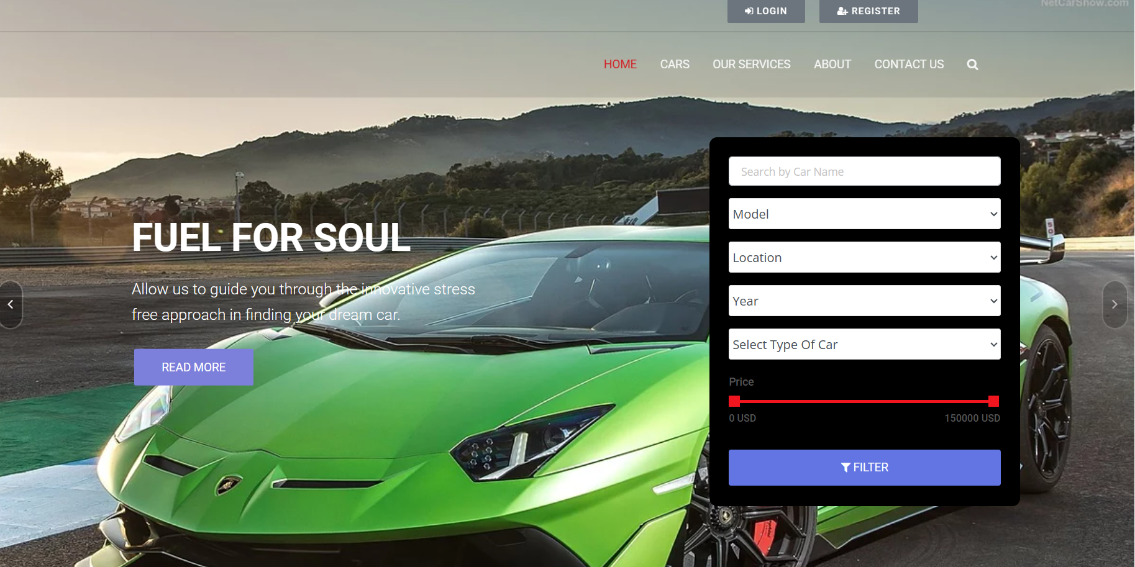
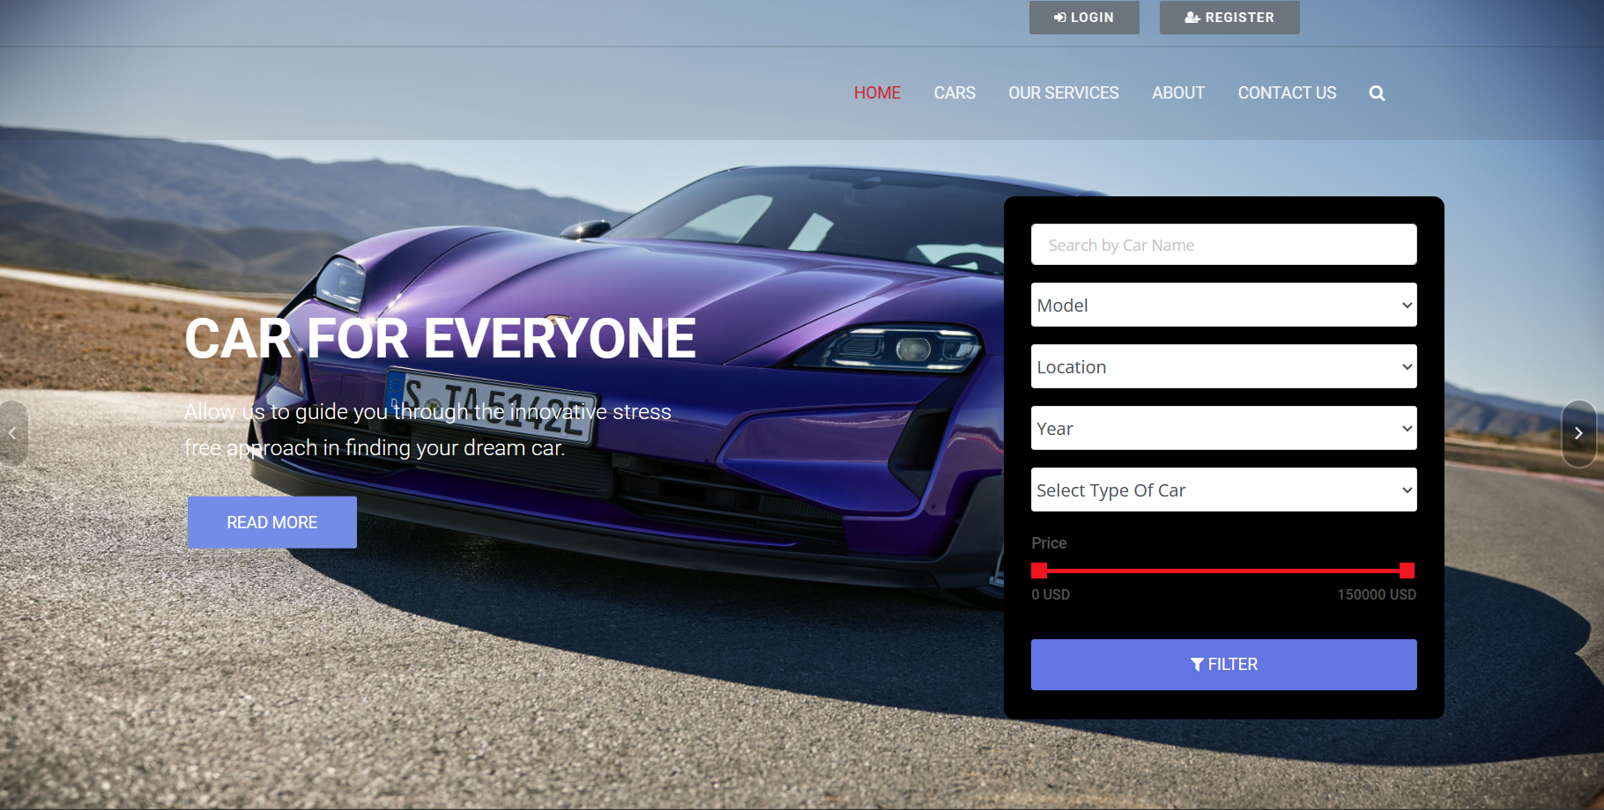
Homepage

Slide 12
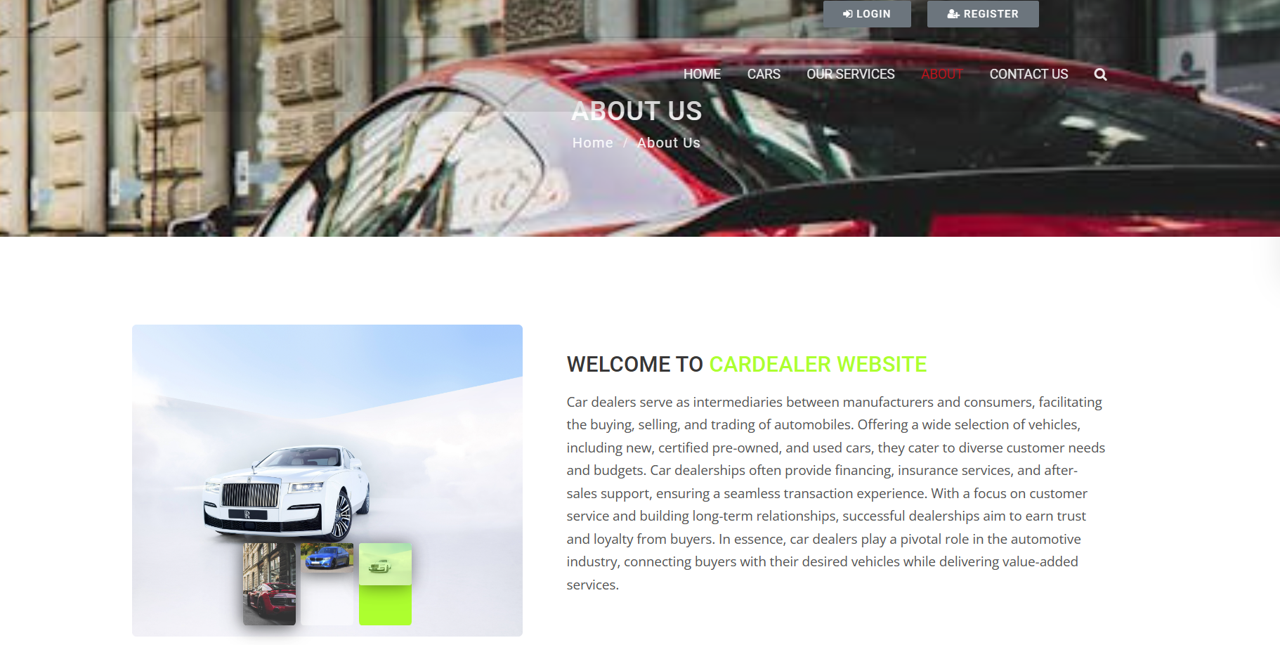
About-Us-Page

Slide 13
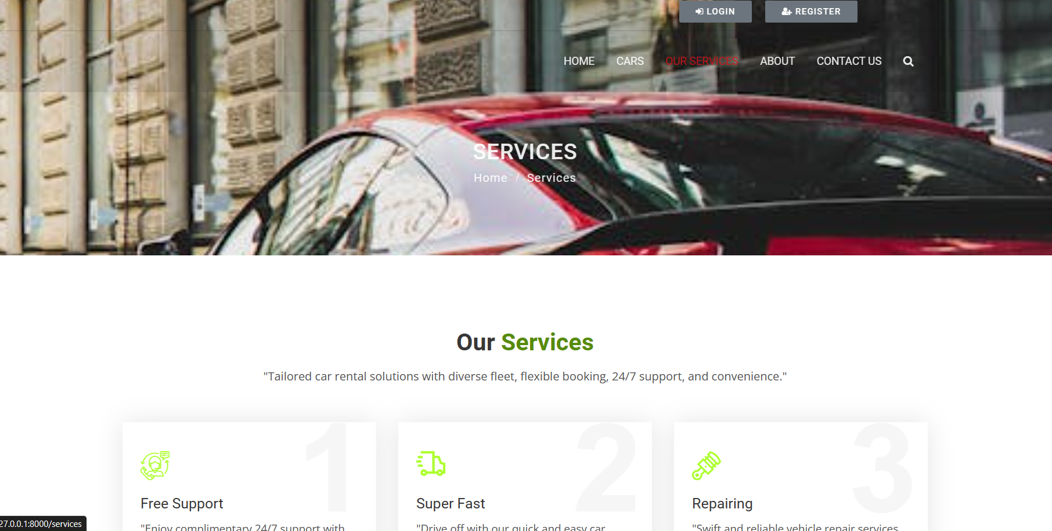
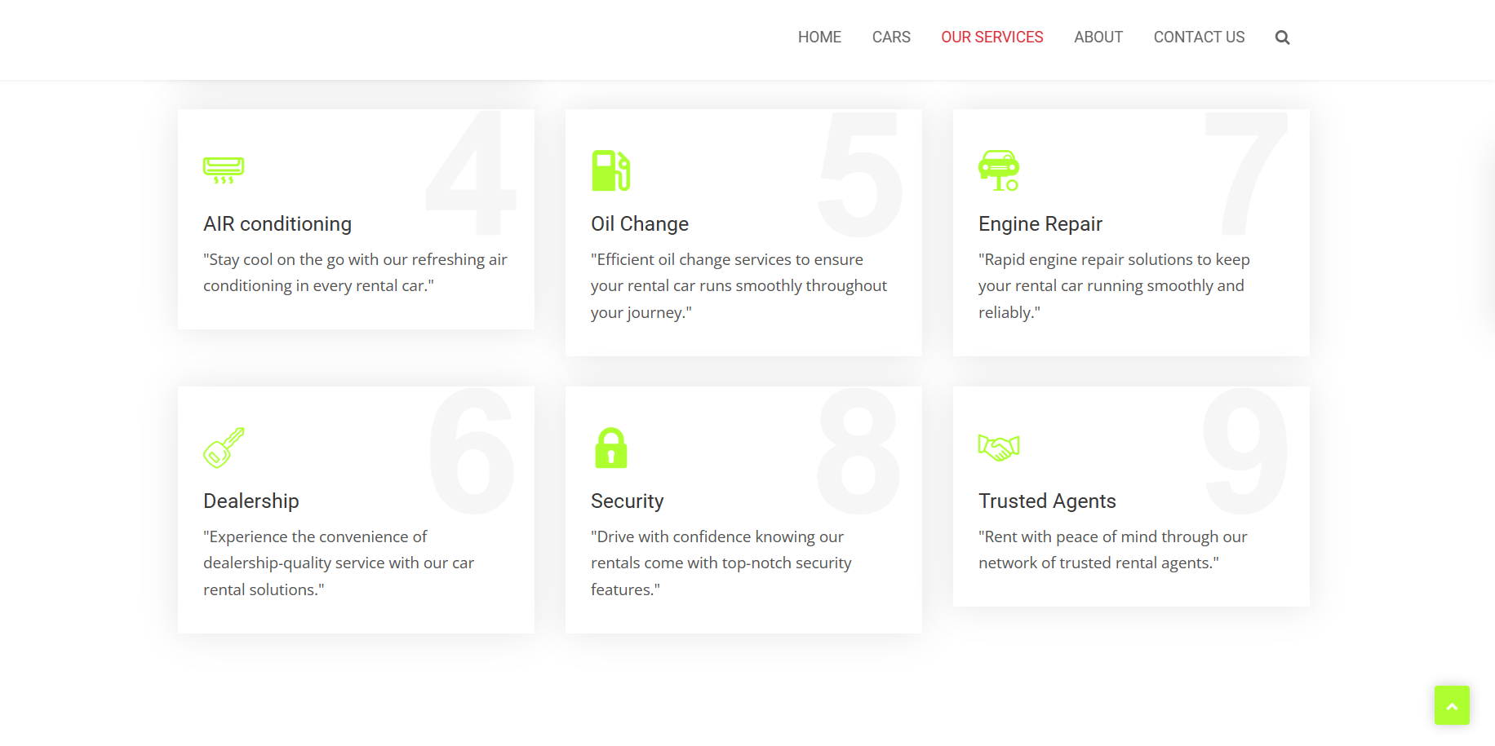
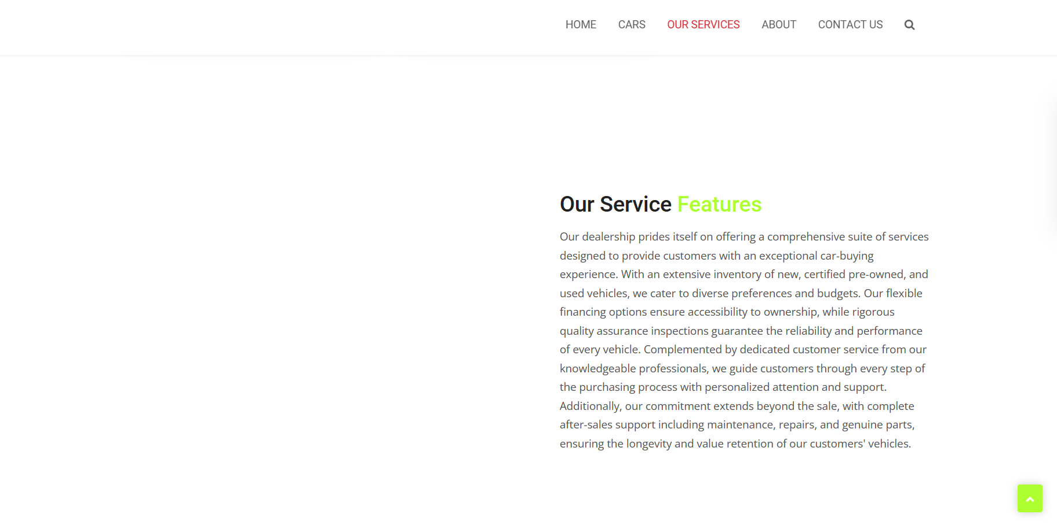
Service-Page

Slide 14
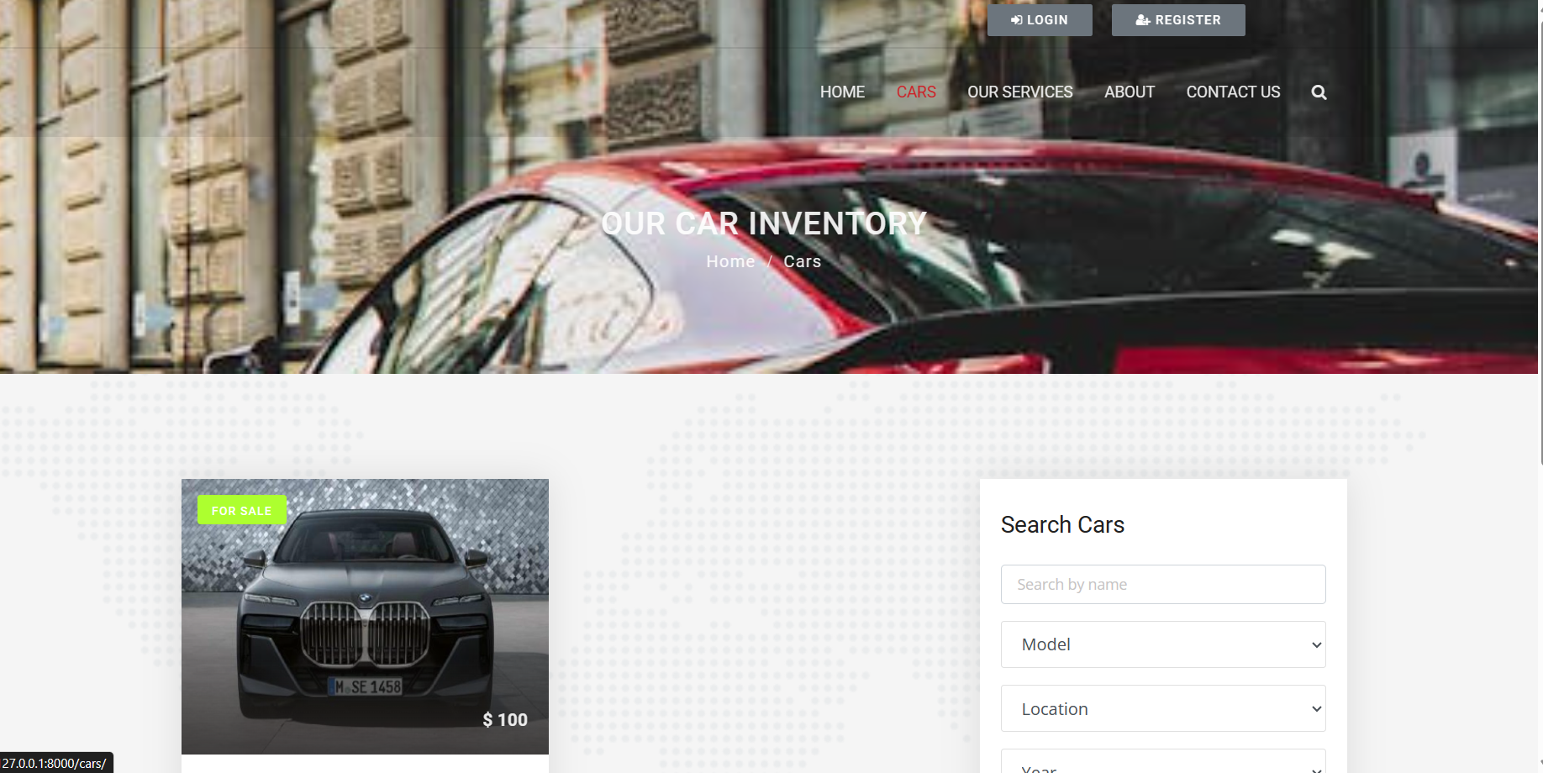
Car-Page

Slide 15
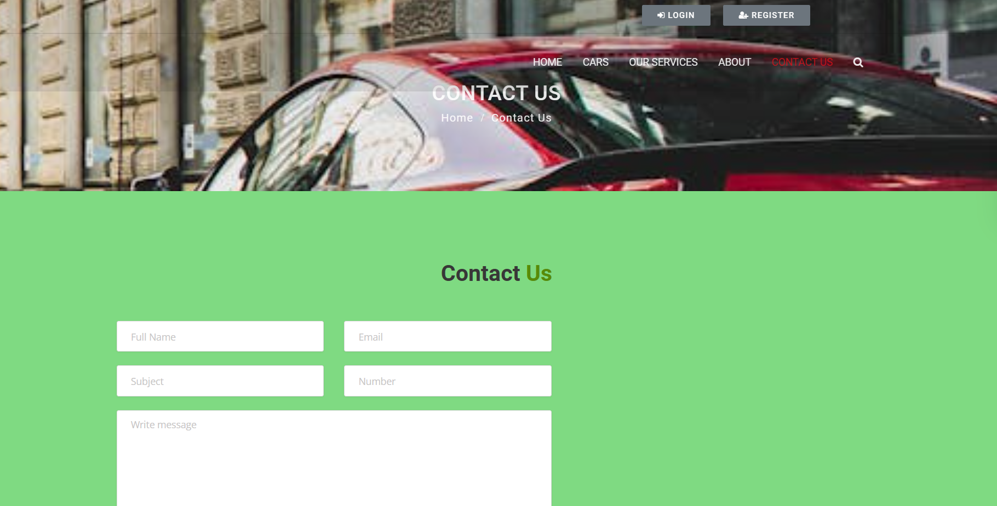
Contact Us-Page

Slide 16
Future Enhancements:
Several enhancements can be considered for a car rental application built with Django to improve user experience, functionality, and overall efficiency:
Payment Integration: Integrate payment gateways to facilitate online payments for bookings, providing users with a seamless and secure payment experience.
Rating and Review System: Implement a rating and review system to allow users to provide feedback on their rental experiences, helping other users make informed decisions.
Advanced Search Filters: Enhance the search functionality with advanced filters such as vehicle type, fuel type, transmission, and amenities, enabling users to find specific cars more efficiently.
Notifications: Implement a notification system to keep users informed about their bookings, including booking confirmations, reminders, and updates on booking status.
Dynamic Pricing: Introduce dynamic pricing based on factors such as demand, seasonality, and availability, optimizing rental rates to maximize revenue and utilization of the car fleet.

Slide 17
Conclusion
In conclusion, the car rental application developed using the Django framework offers a modern and efficient solution for users seeking to rent cars. With a user-friendly interface, robust features, and secure functionalities, the application aims to revolutionize the car rental industry by providing a seamless booking experience. By incorporating advanced search options, secure payment gateways, and a comprehensive admin panel, the application ensures convenience for both customers and rental service providers. Continuous updates, scalability considerations, and adherence to industry standards contribute to the application's reliability and success in meeting the diverse needs of users. Overall, the car rental application with Django framework presents a promising and innovative approach to enhancing the rental experience for all parties involved.
Source :

Slide 18
Thank You!
Notes:
Thank You !!

